Slide 1

Building & Mining Knowledge Graphs
(KEN4256)
Lecture 1: What are Knowledge Graphs and what are they used for?
Michel Dumontier and Kody Moodley

Slide 2
Lecture outline
Course logistics
The ‘What’ and ‘Why’ of knowledge graphs
Applications of knowledge graphs
Knowledge graph representations

Slide 3
Course logistics
Instructors: Michel Dumontier and Kody Moodley
Teaching assistants:
Amrapali Zaveri (Knowledge graph quality)
Vincent Emonet (Knowledge graph construction & querying)
Remzi Celebi (Knowledge graph completion)
Ricardo Moreira Da Rocha De Miranda Azevedo (FAIR knowledge graphs)

Slide 4
Schedule*
Week 1: What are knowledge graphs and what they are used for?
How to construct knowledge graphs (RDF)
Exploring examples of knowledge graphs (Wikidata & DBpedia)
Week 2: FAIR knowledge graphs, metadata & provenance
How to assess FAIRness of knowledge graphs
Metadata & provenance of information in knowledge graphs
Week 3: Querying & mining knowledge graphs
Week 4: Knowledge graph completion
CARNIVAL
Week 5: Knowledge graph quality
Week 6: Social, legal & ethical aspects of knowledge graphs
Gijs van Dijck, Marcel Schaper
Week 7: Project presentations
* may change during the course

Slide 5
Evaluation
2 Group assignments to build knowledge and skill (40%; 20% each)
Assignment 1: released on Web Feb 6; due Wed Feb 20
Assignment 2: released on Wed Feb 27; due Wed March 18
1 Individual project to demonstrate your creativity and technical virtuosity (60% - 15% proposal, 35% report, 10% presentation)
2 page proposal: due March 1; feedback within 1 week.
presentations: March 20, 25, 27 (4 sessions)
report: due April 1

Slide 6
Project
Provides knowledge for
Please attend the lectures & labs!
Assignments
Provides knowledge for
Labs & lectures

Slide 8
Why are you here?

Slide 9
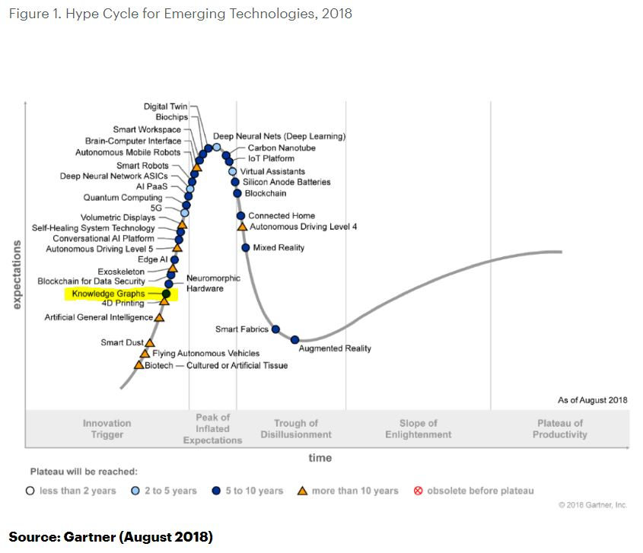

Slide 10
What is a knowledge graph?

Slide 11
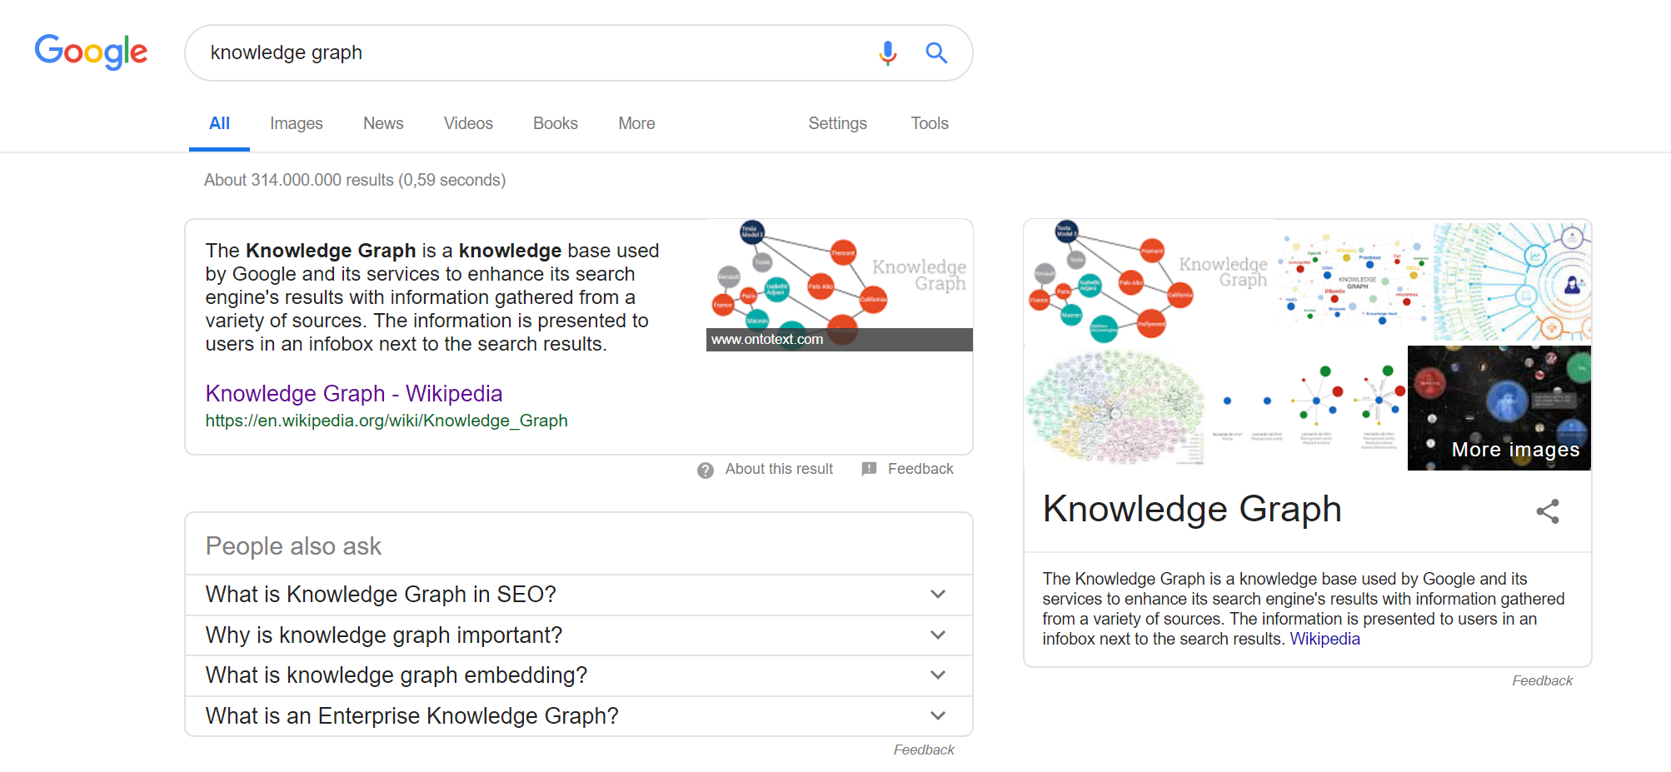
Notes:
A knowledge graph is a special kind of database which stores knowledge in a machine-readable form and provides a means for information to be collected, organised, shared, searched and utilised.

Slide 12
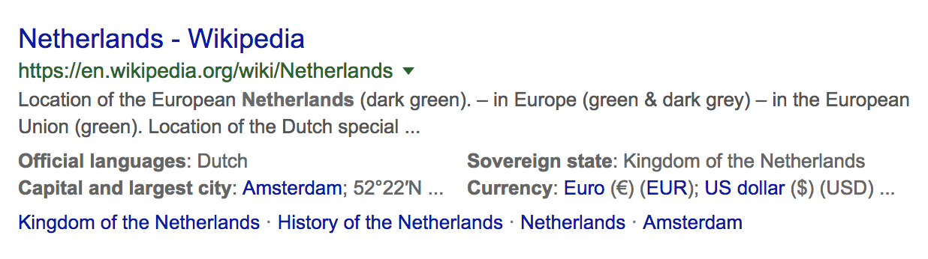
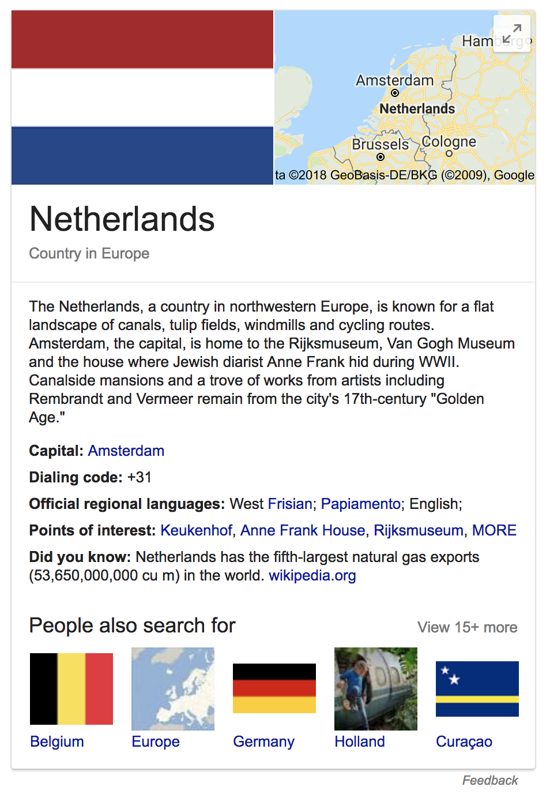
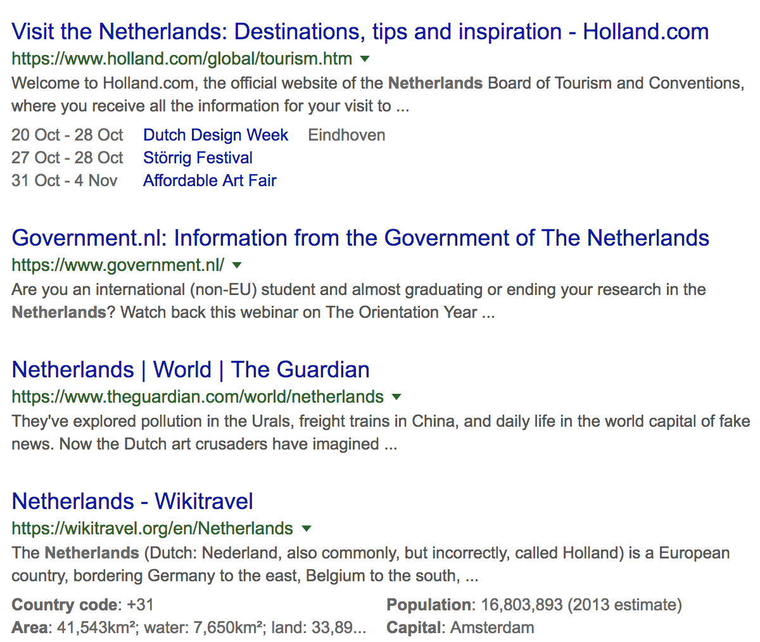
Notes:
So, search results are no longer just lists of snippets pointing to pages that are ordered by information retrieval scores and PageRank.

Slide 13
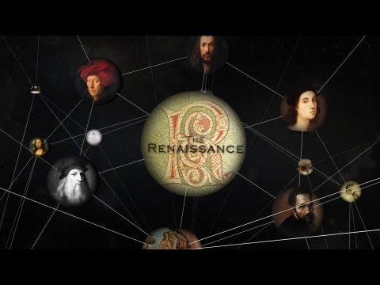

Slide 14
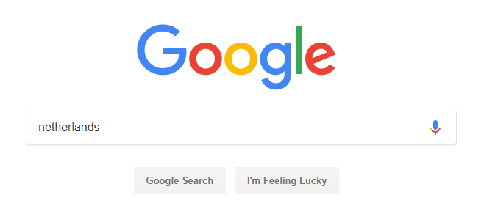
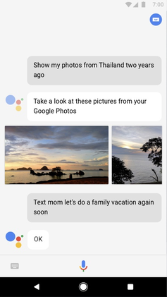
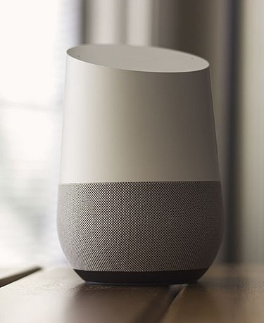
The Google Knowledge Graph is used for
Google Search
Google Voice Assistant
Google Home Services

Slide 15
What is a knowledge graph?

Slide 16
History around the term knowledge graph
1956, Rene Bakker (Utrecht) developed the notion of a Knowledge Graph in his Ph.D. Thesis as a way of structuring and representing scientific knowledge.
1974, Marchi and Miguel defined a knowledge graph as a mathematical structure with vertices as knowledge units connected by edges that represent the prerequisite relation. Units of knowledge are only accessible if other units are previously known.

Slide 17
A (widely agreed) definition for the term
knowledge graph is lacking.
“...the use of the term has evolved and now may refer to a wide range of graphs, that may not include clear and unambiguous definitions or references.”
McCusker et al. (2018), What is a Knowledge Graph?
“We define a knowledge graph as: a graph, composed of a set of assertions (edges labeled with relations) that are expressed between entities (vertices), where the meaning of the graph is encoded in its structure, the relations and entities are unambiguously identified, a limited set of relations are used to label the edges, and the graph encodes the provenance, especially justification and attribution, of the assertions.”
McCusker et al. (2018), What is a Knowledge Graph?

Slide 18
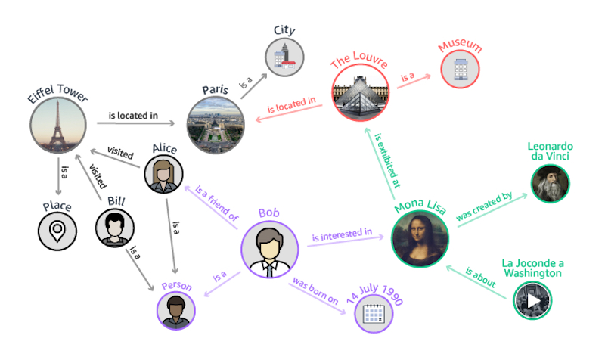
entity
relation
context:
when is the relation valid?
how did it come into existence?
who or what was involved?
statement provenance:
when was the statement made?
who made the statement?
how was it made?
where was it reported?
what are the terms of use?
instance
type
attribute

Slide 19
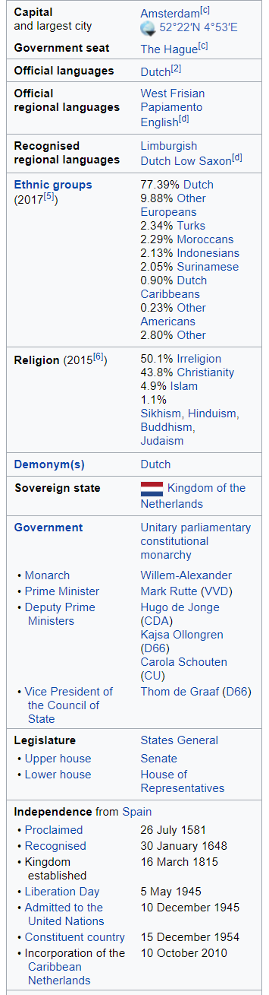
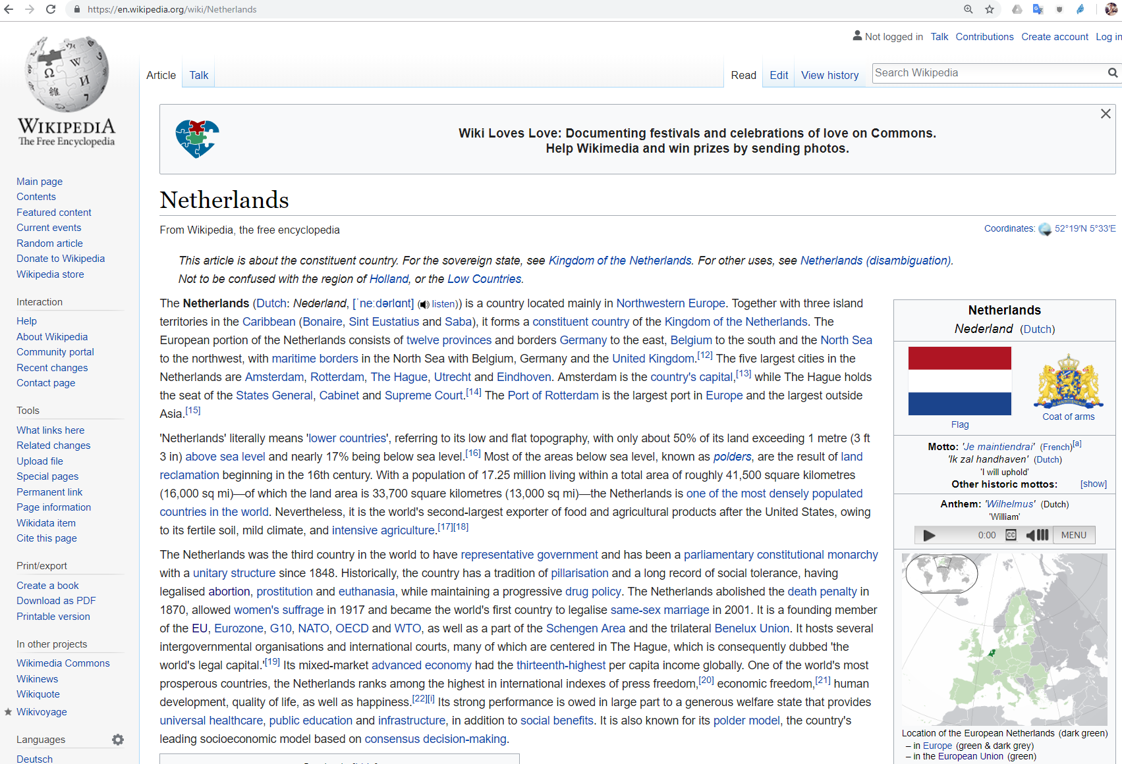

Slide 20

Crowdsourced community effort to extract structured content from information created in various Wikimedia projects
Structured information resembles an open knowledge graph which is available for everyone on the Web
English version of the DBpedia knowledge base describes
4.58 million things,
out of which 4.22 million are classified in a consistent ontology,
including 1,445,000 persons, 735,000 places , 241,000 organizations etc.
Localized versions of DBpedia in 125 languages
8.8 billion fact, large-scale-cross-domain knowledge graph

Slide 21
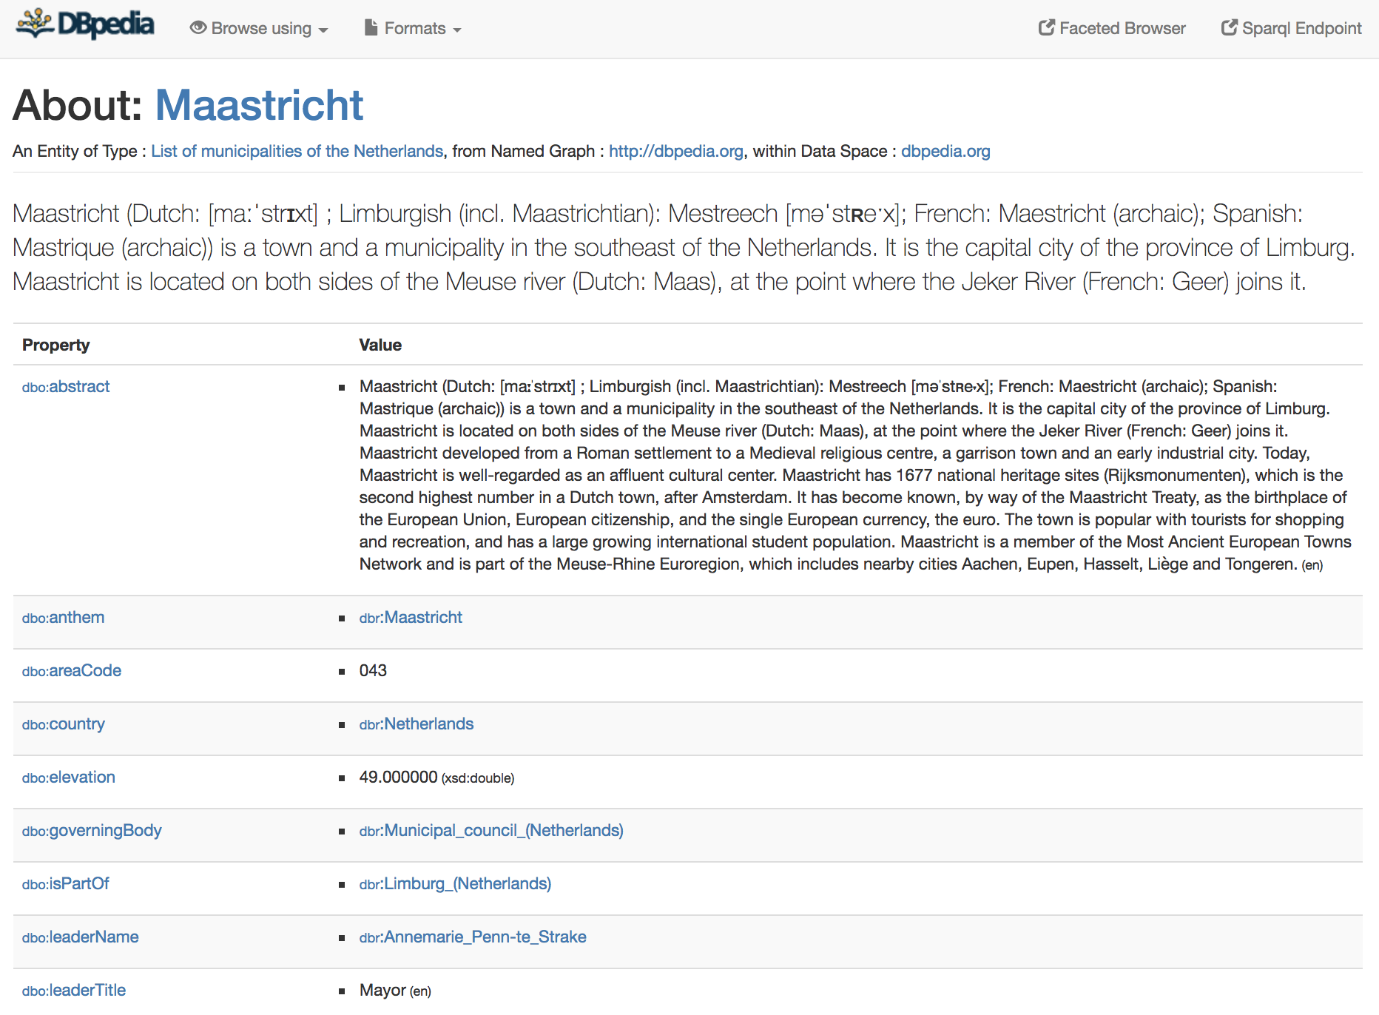
http://dbpedia.org/page/Maastricht
Notes:
Interlinked with other datasets

Slide 22
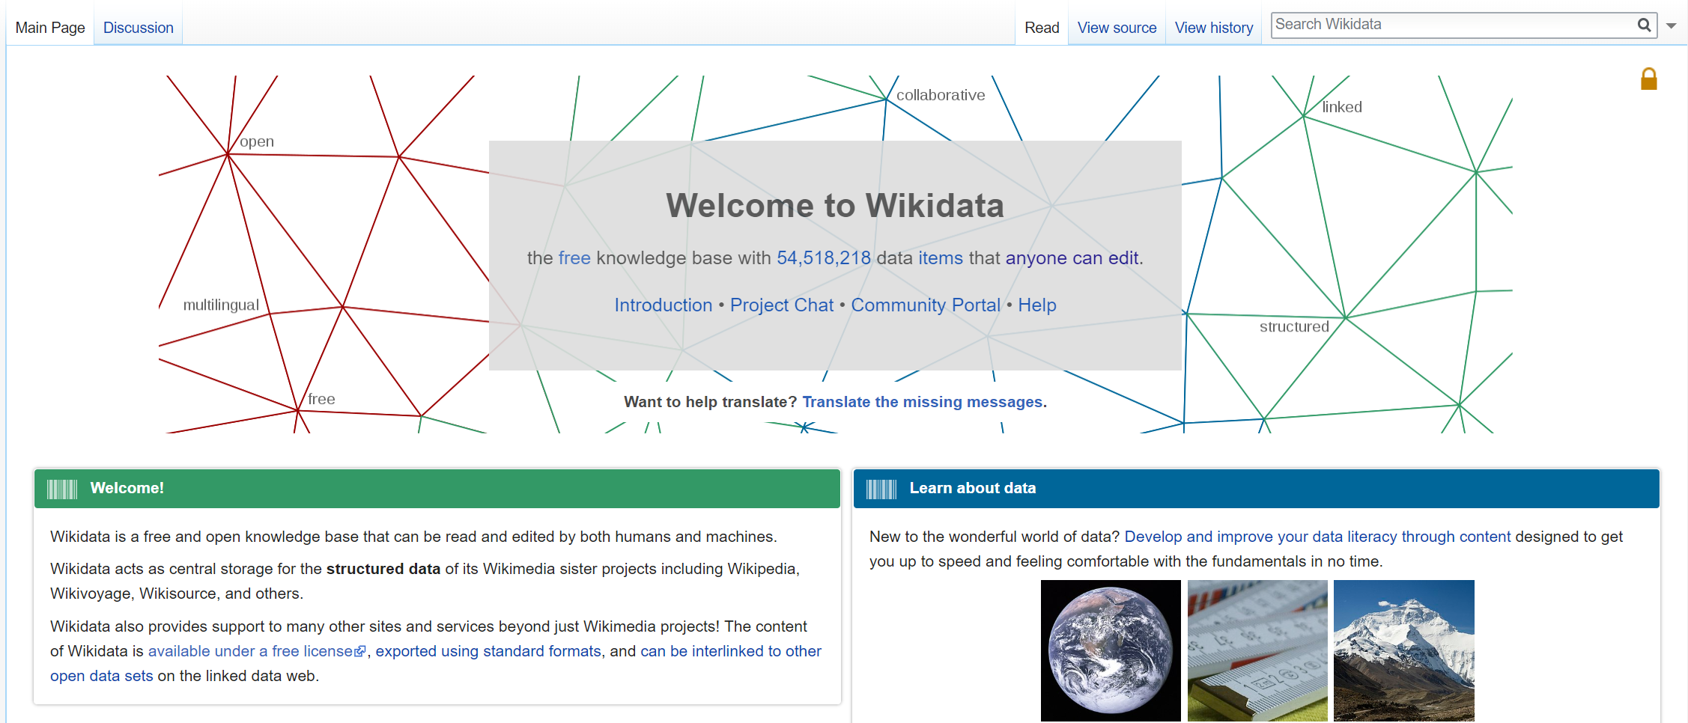

Slide 23
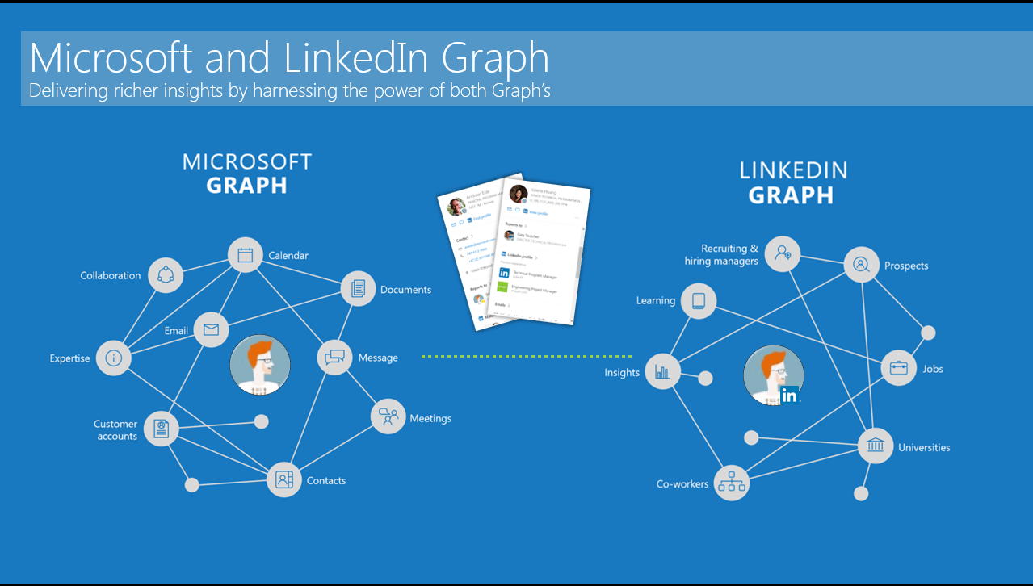
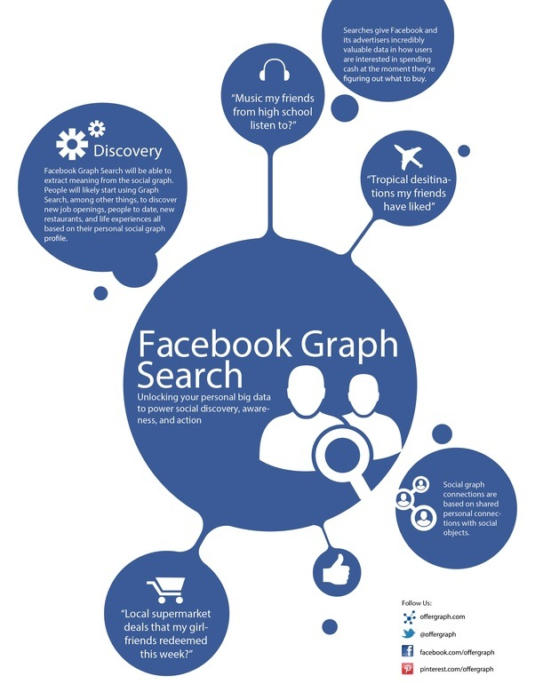


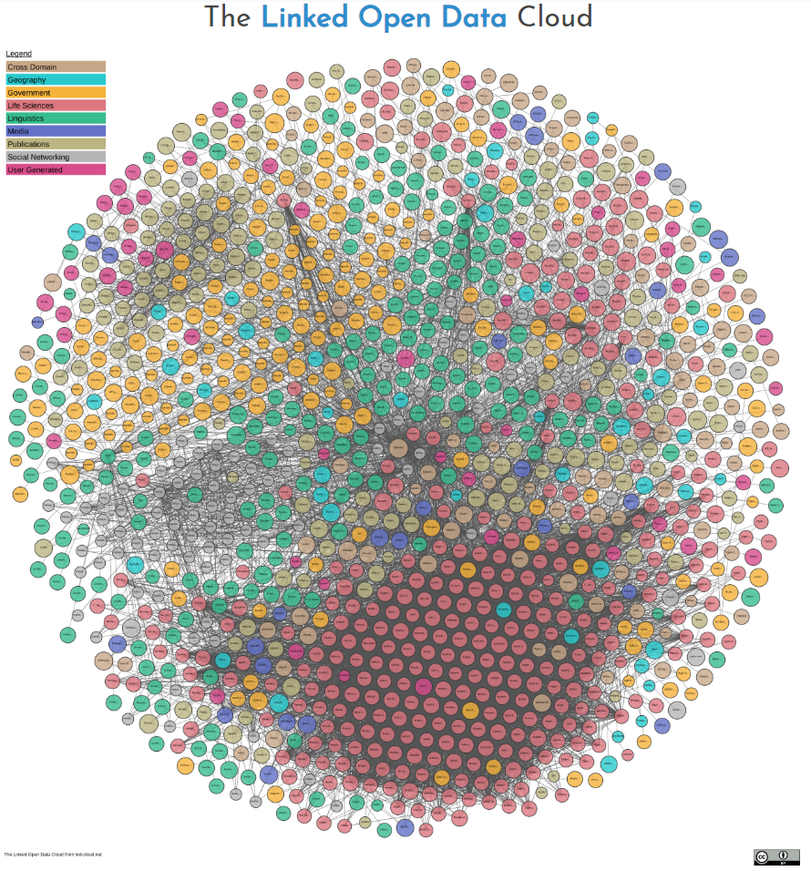





Slide 24
What are they used for?

Slide 25
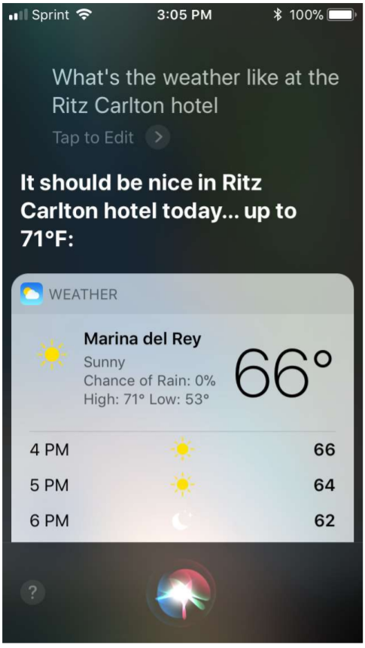
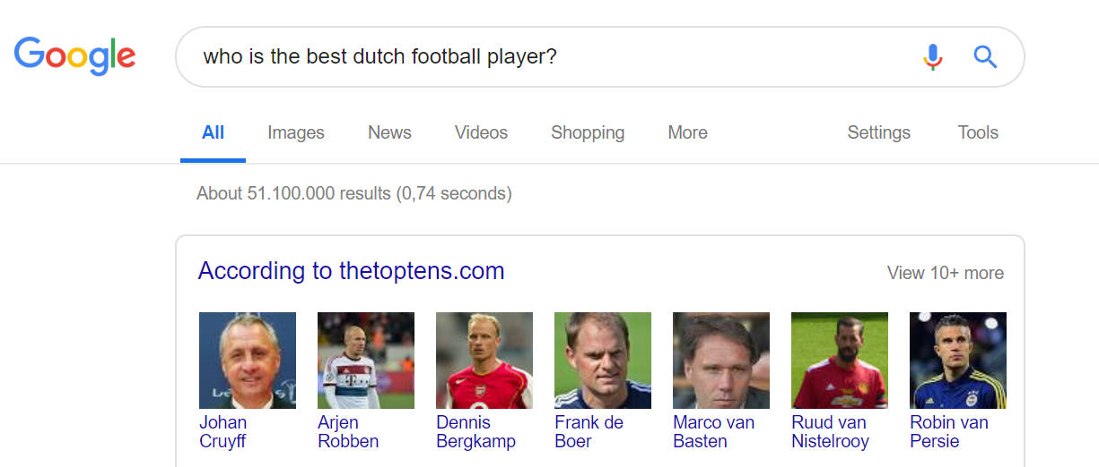
Query Answering
Source: kgtutorial.github.io

Slide 26
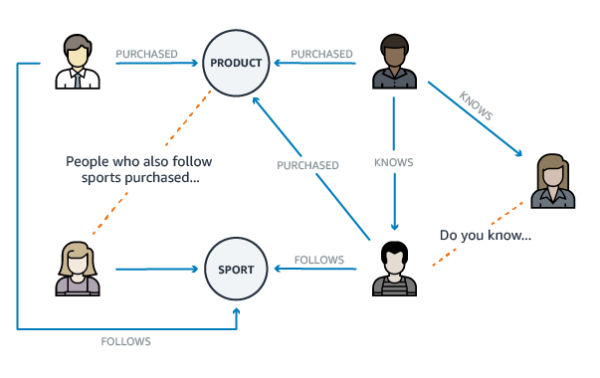
Recommendations
Source: https://geomarketing.com

Slide 27
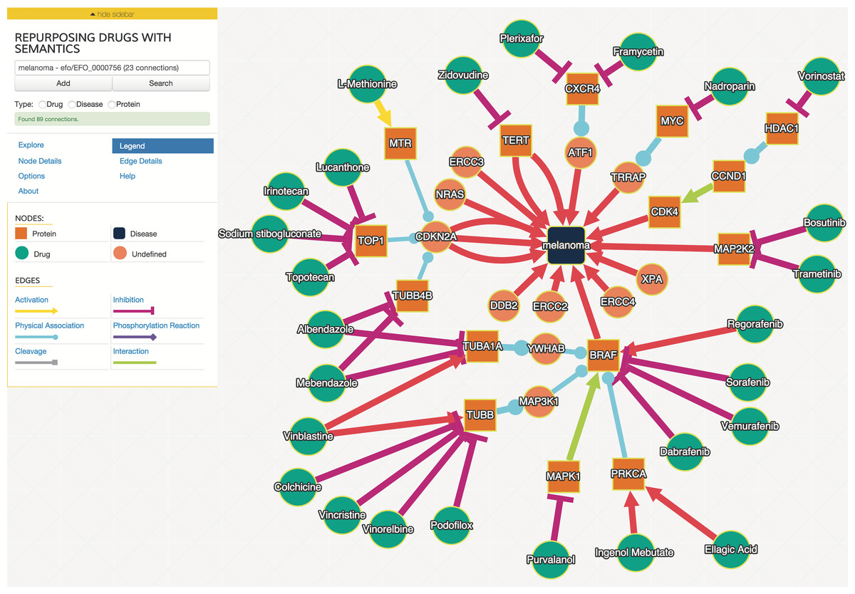
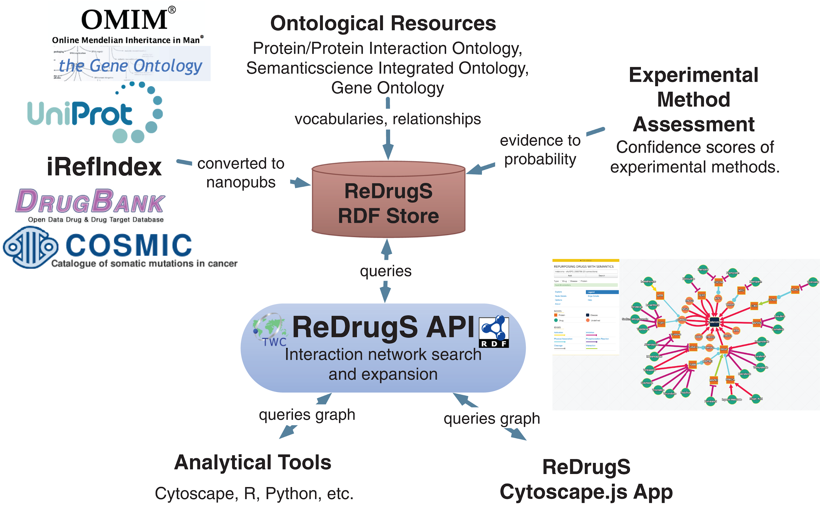
Discovery science

Slide 28
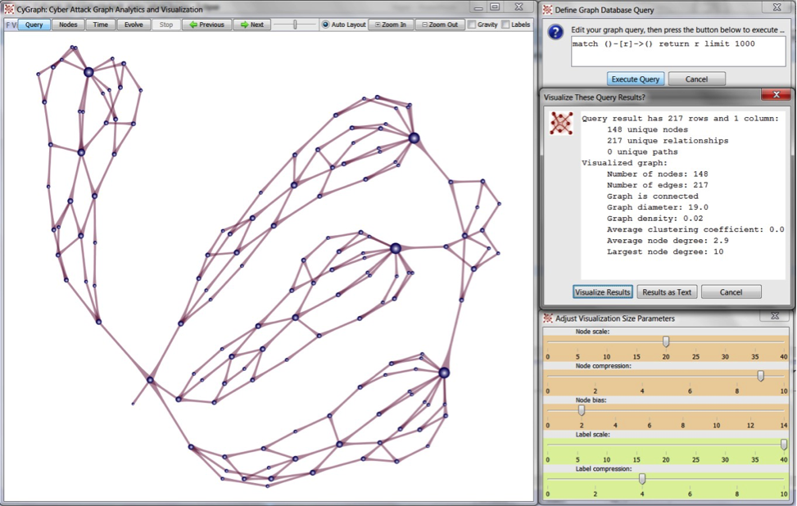
Cybersecurity

Slide 29
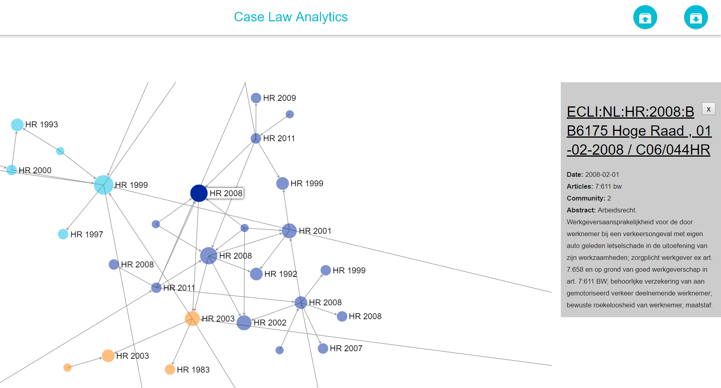
Understanding the evolution of law

Slide 30

Building a smarter AI
IBM Research undertook a challenge to build a computer system that could compete at the human champion level in real time on the American TV quiz show, Jeopardy
Led to building of the DeepQA architecture and the implementation of Watson
DeepQA leverages semistructured and structured content, which include databases, taxonomies, and ontologies, such as DBpedia, WordNet and the Yago ontology
http://www.aaai.org/Magazine/Watson/watson.php

Slide 31
Why represent knowledge
as graphs?

Slide 32
Graphs as a KR paradigm
Accessible to humans and machines
Graph paradigm is intuitive for humans to understand
Graphs can be encoded with a formal semantics for machine interpretation
Facilitates integration of heterogeneous knowledge
knowledge from different domains can be combined:
Use of shared relations/vocabularies
Creating links between entities from different datasets
Enables analysis
Decades of research on graph analysis & querying algorithms can be reused to explore, mine and analyse KGs

Slide 33
geo-objects
travel network
art history
social network
linking relations

Slide 34
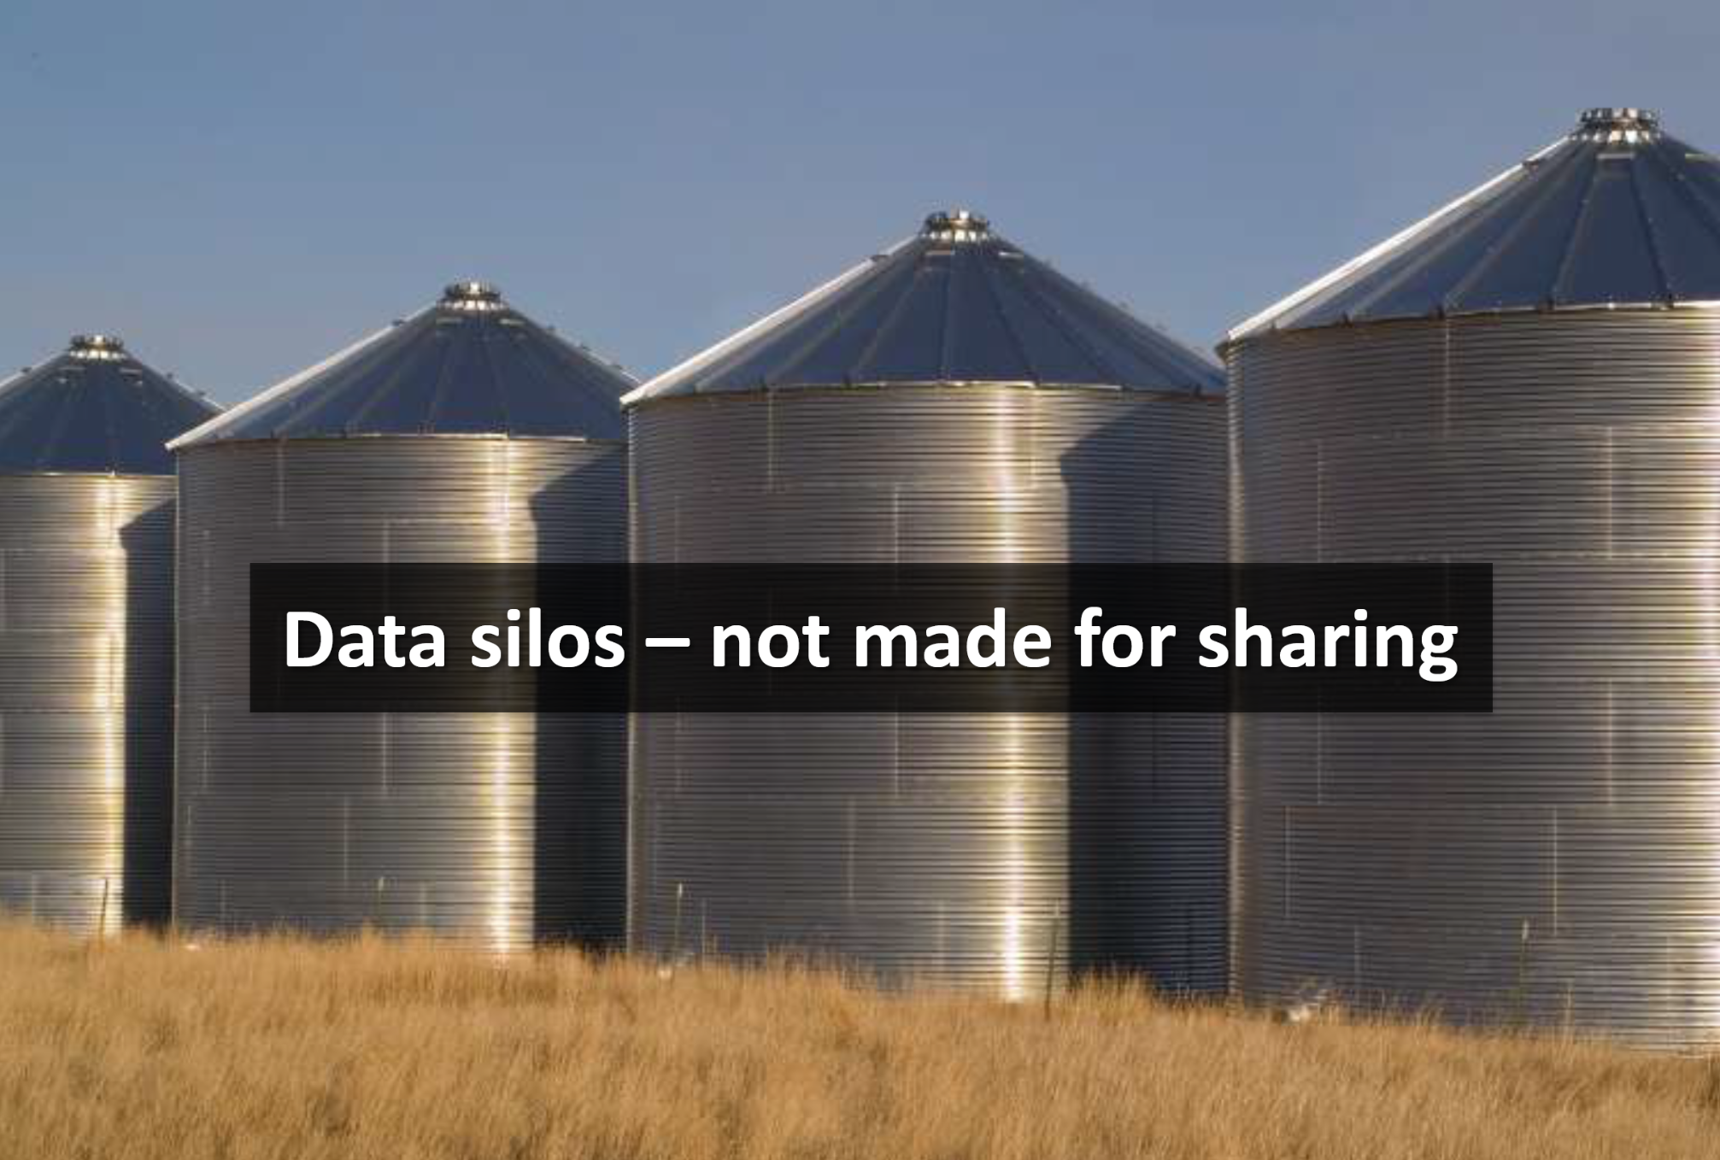

Slide 35
How do we represent KGs?

Slide 36
Long history of KR & graph representation
Existential Graphs (1896; Peirce)
Semantic Networks
Conceptual Graphs
Cognitive Semantic Networks
Structured Inheritance Networks
Multilayered Extended Semantic Networks (MultiNets)
Basic Conceptual Graphs
Full Conceptual Graphs
Hierarchical Semantic Form
Resource Description Network (RDF)
Property Graph

Slide 37
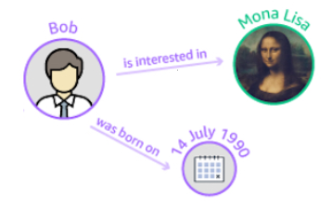
Resource Description Framework
Graph-based method for knowledge representation on the world wide web.
Resources (any thing) are named with Uniform Resource Identifiers (URI)
Binary relations are directed, and expressed using a named property (annotations on the named property are shared in all graphs containing it).
Values of relations can be a URI or a Literal
http://rel.io/P1
https://en.wikipedia.org/wiki/Mona_Lisa
http://bob.info/me
http://relationsRus.org/wasBornOn
xml:DateTime

Slide 38
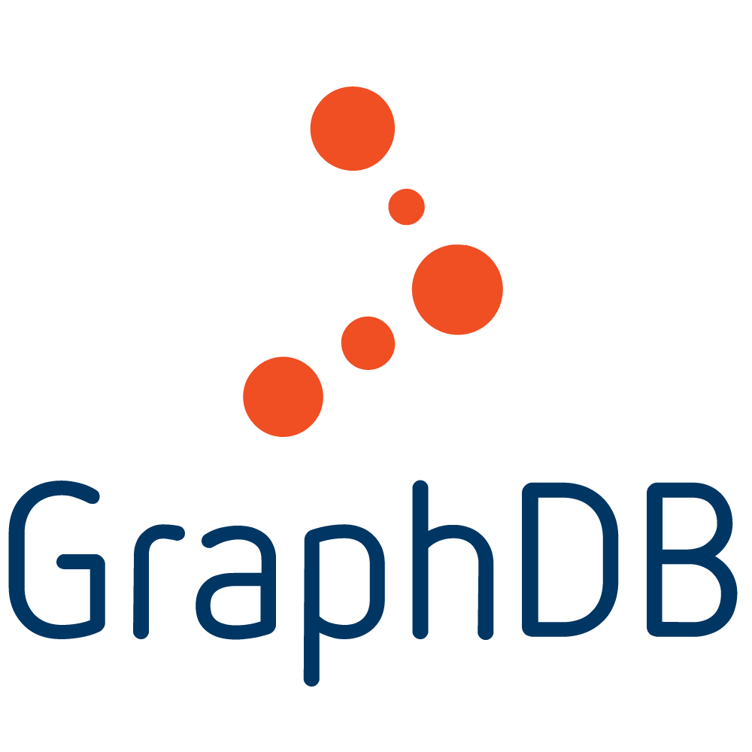



Semantic graphs
RDF store implementations
Formalism
Query language

Slide 39
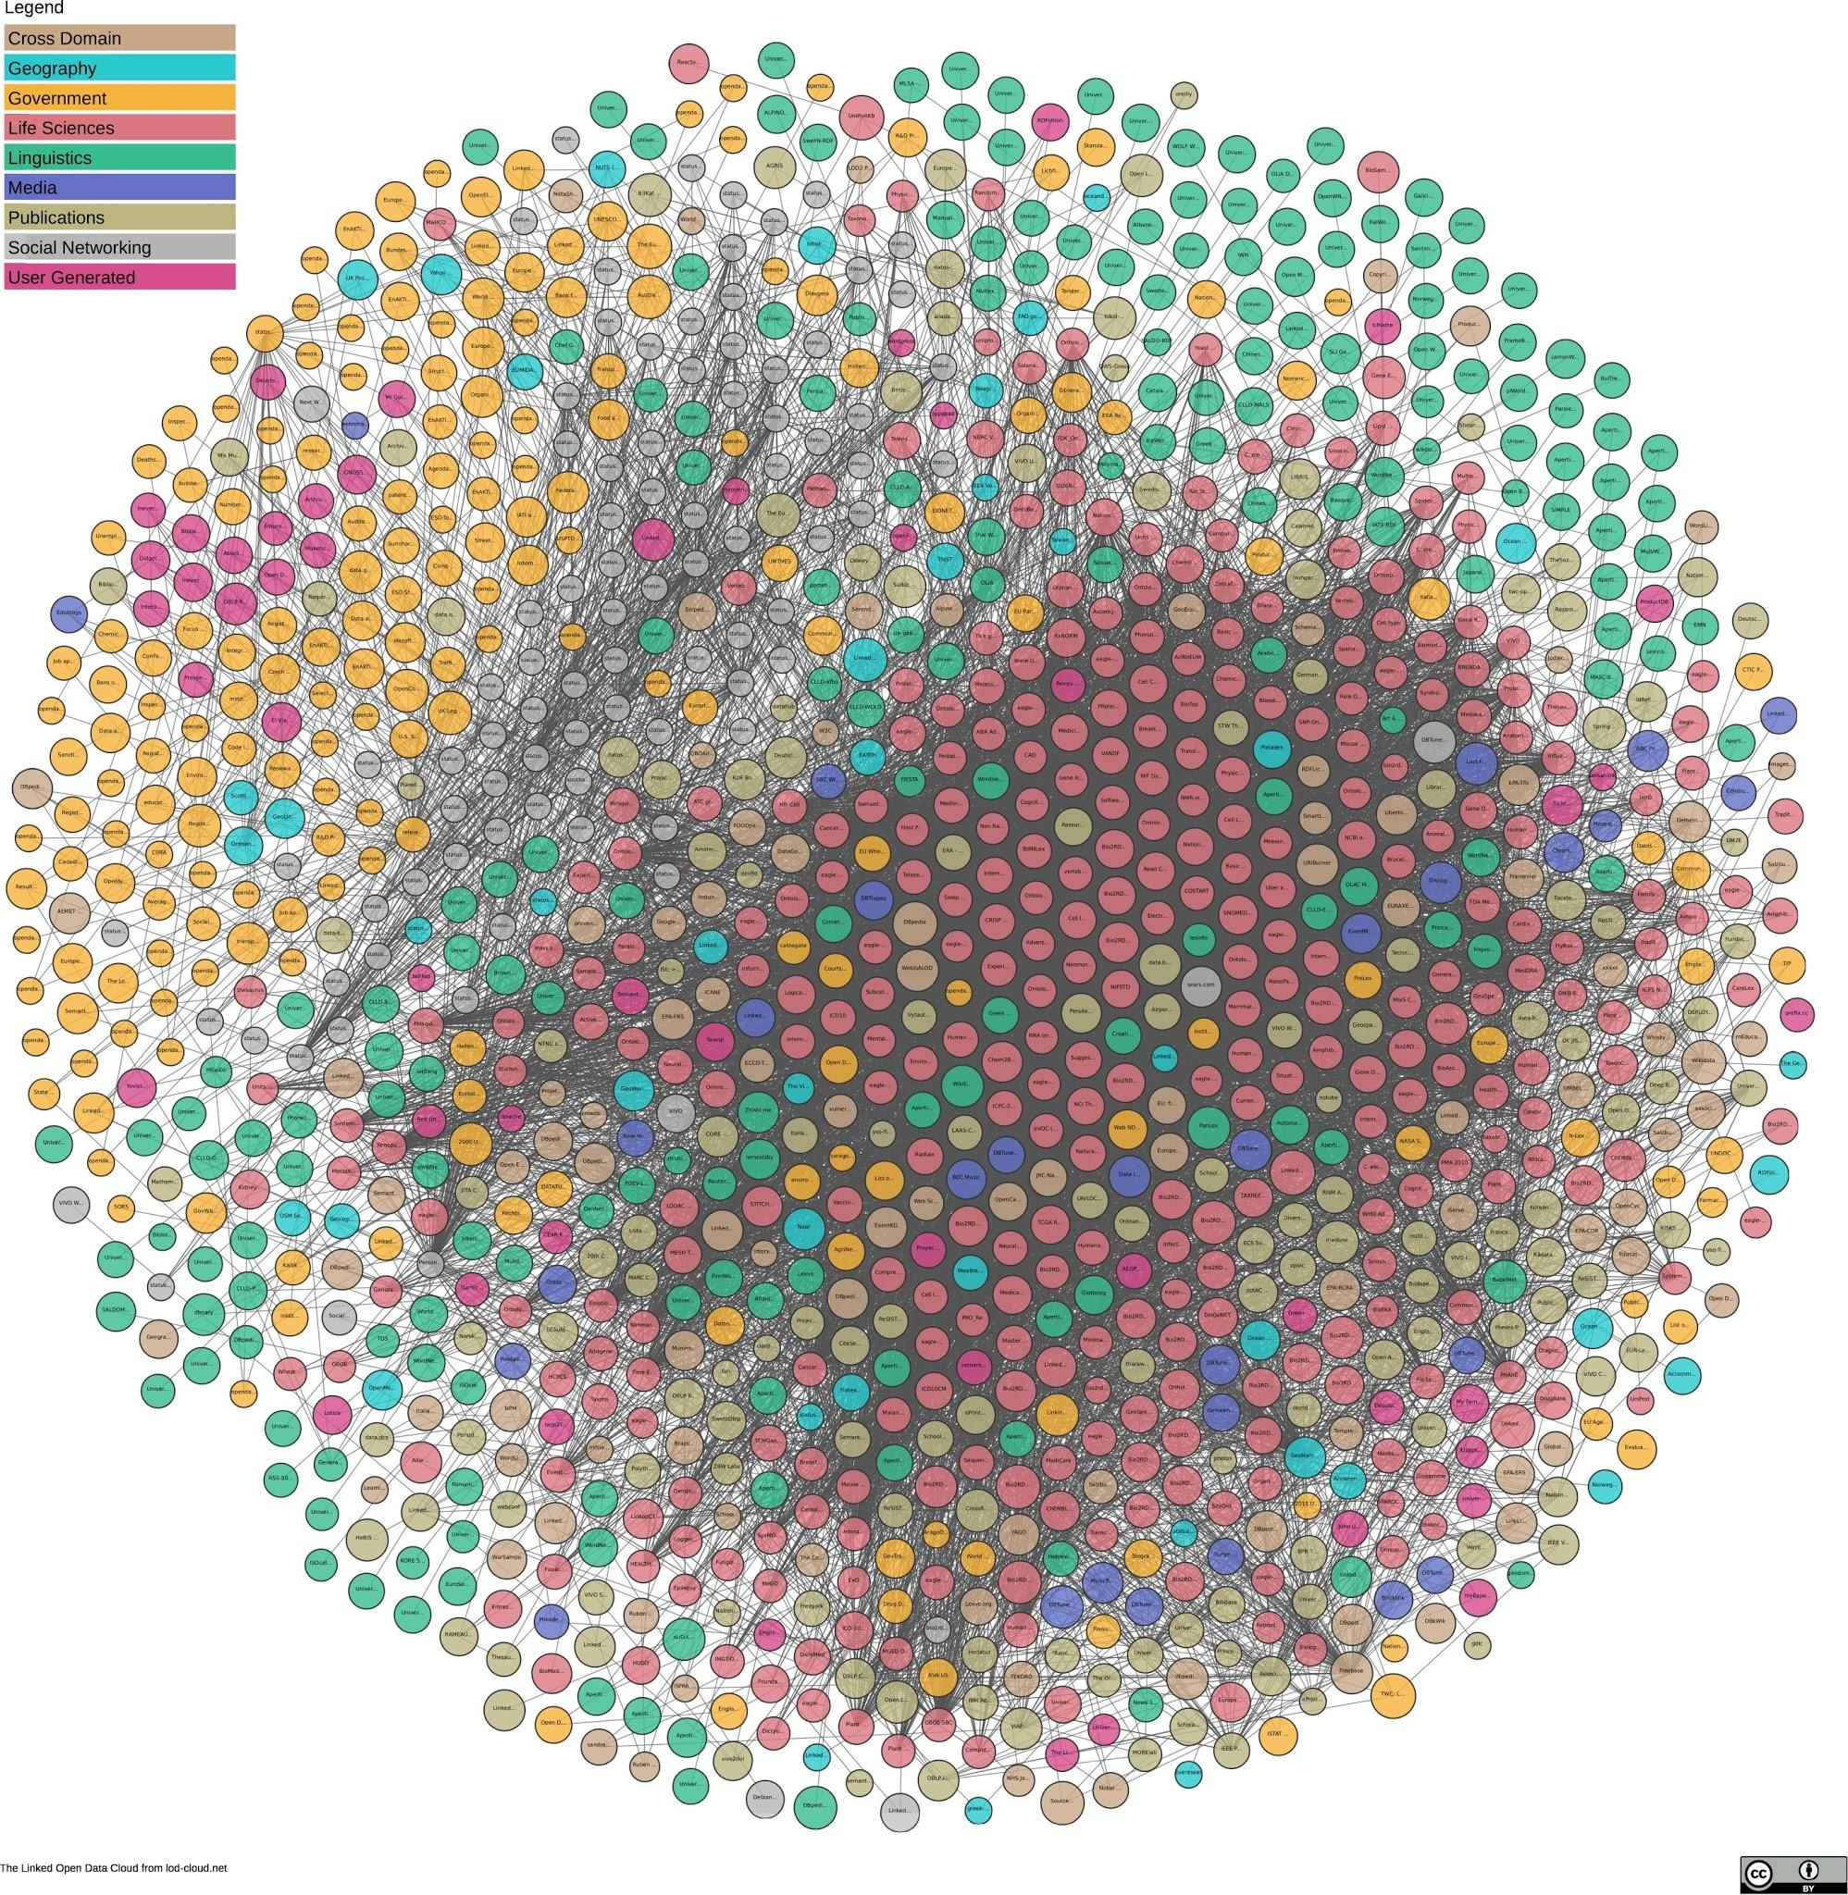
https://lod-cloud.net/
1,224 datasets
with 16,113 links
(as of June 2018)
Notes:
DBpedia is nucleus of LOD

Slide 40
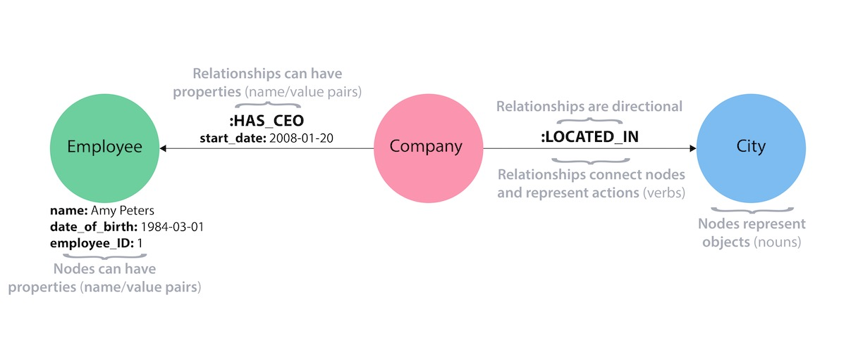
Property Graph
a property graph is an attributed, multi-relational graph. edges are labeled and both vertices and edges can have any number of key/value properties associated with them

Slide 41

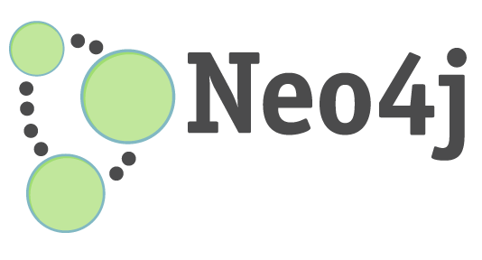
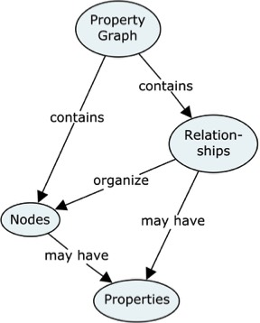
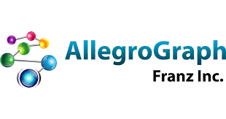

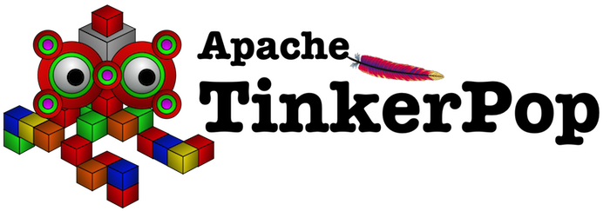
Property graphs
Graph database implementations
Formalism
Query languages
GraphQL
Cypher
Gremlin

Slide 42
Summary
Knowledge Graphs are very old and very new at the same time
Many definitions of knowledge graphs
Many representations for knowledge graphs
Many instances of knowledge graphs
Many ways to access knowledge graphs
You will learn how to build and mine specific representations and instances of knowledge graphs in a very short period of time!

